Slide 1

Predicting Customer Churn
for
Telecom Company

Slide 2
Agenda
Problem Statement
Business Overview
Data Collecting and Pre-processing
Model Building
Regression Analysis
Model Assumptions
Business decisions and recommendation.

Slide 3

Problem Statement
Churned Customers are those who have decided to end their relationship with their existing company. It can happen because of variety of reasons like- a) Bad customer Service b) Bad Onboarding c) Lack of Ongoing Customer Success.
Why is it important?
Churned Customers means a direct loss of Marketing Acquisition Cost and possible revenue which could be capitalized post sale. Hence, predicting possible customers who can churn beforehand can help us save this loss.

Slide 4
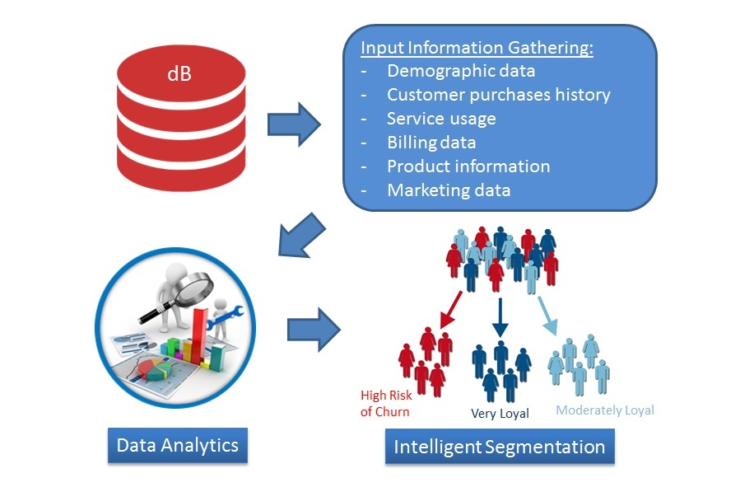
Business Overview

Slide 5
Data Collecting and Pre-processing
Loading Dataset into R environment.
Dataset with: Observations - 7043.
Variables - 20.
Detecting and treating the missing values in dataset.
Here Total Charges contains missing values i.e. NA. But as only 11 missing values were there, so we preferred to remove those.
- Converting necessary variables into factors so that model can do well and predict the
the response variable very well.
Splitting dataset into two model:
Development Model
Testing Model

Slide 6
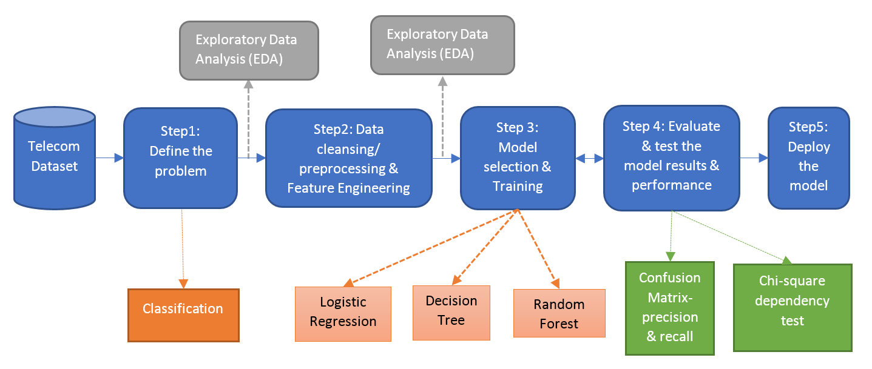
Model Building

Slide 7
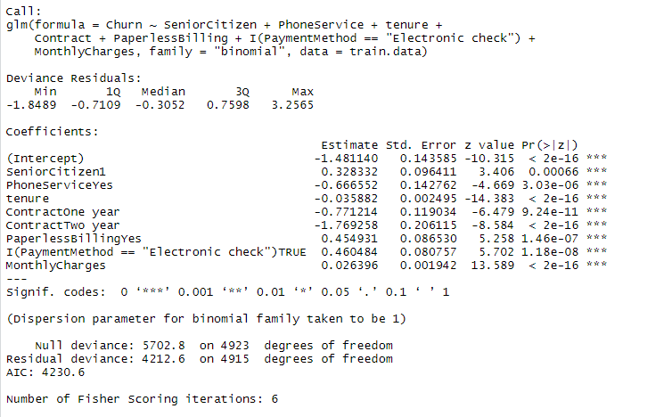
Regression Analysis

Slide 8
Customer with contract of one year and two years are less likely to churn.
Company providing good phone service, that’s why customers with phone service are less likely to churn.
Customer with Paperless billing are likely to churn, so company need to improve their service in the area of paperless billing. Also the Payment method Electronic check, company needs to work on it, customers with payment method electronic check are more likely to churn.
Company need to consider different group of age while planning strategy. Senior citizens are more likely to churn.

Slide 9
Business Decisions and recommendation
Customer with contract of one year and two years are less likely to churn.
Company providing good phone service, that’s why customers with phone service are less likely to churn.
Customer with Paperless billing are likely to churn, so company need to improve their service in the area of paperless billing. Also the Payment method Electronic check, company needs to work on it, customers with payment method electronic check are more likely to churn.
Company need to consider different group of age while planning strategy. Senior citizens are more likely to churn.

Slide 10
Thanks you!

